Slide 1
Toolkits of target identification: compound screening and CRISPR
An exploratory analysis

Slide 2
Questions
How many genes have well annotated chemicals? 200 genes
What are the specificity and sensitivity numbers look like for CRISPR method in knocking down one gene in a fixed cell line? 90%
How generalizable are the CRISPR conditions to other genes in genome-wide pool/arrayed platforms? 30% sensitivity
Where are false-positive results from CRISPR methods coming from and how prevalent they are? below 10%
Where are false-negative results from CRISPR methods coming from and how prevalent they are? 30% sensitivity

Slide 3
Summary
Objective
To estimate sensitivity and specificity of compound screening and genome-wide CRISPR for target identification
Data
LKB1 project 54 compounds screening results
Achilles CRISPR results

Slide 4
Compound screening data
Data: 21 Cells (9 LKB1 WT and 12 LKB1 LOF); 54 compounds; 42 target / target groups
QC: the experiment run two replicates for each compound and cell pair; we looked at replicates consistency
Each dot is EC50 value of a compound and cell pair; X and Y axis are the two replicates
We removed 23 compound/cell pairs (18 compounds and 7 cells) showed poor consistency between the two replicates

Slide 5
Break down compounds into three groups
Compound group 2: 10
Strong effects across all the cell lines
Criteria: Max EC50 <= 1e2
Compound group 3: 34
Varying effects across the cell lines
Criteria: everything else
Compound group 1: 15
No effects across all the cell lines
Criteria: 10% quantile EC50 >= 1e4

Slide 6
Compound group 1: no effects in all cell lines

Slide 7
Compound group 1: no effects in all cell lines
Compound | Target | Target gene
L-001748230-001Y002 | ACC 1/2 | ACACA, ACACB
L-006375236-000J001 | ACC 1/2 | ACACA, ACACB
L-004925451-000T006 | AMPK | PRKAA1, PRKAA2, PRKAB1, PRKAB2, PRKAG1, PRKAG2, PRKAG3
L-000572059-001X009 | AMPK activator | PRKAA1, PRKAA2, PRKAB1, PRKAB2, PRKAG1, PRKAG2, PRKAG3
L-000657335-000C019 | AMPK/VDAC1 | PRKAA1, PRKAA2, PRKAB1, PRKAB2, PRKAG1, PRKAG2, PRKAG3, VDAC1
L-006338471-000G001 | CDK4/6 | CDK4, CDK6
L-000791398-000A026 | COX-2 | PTGS2
L-001719740-000P001 | FASN | FASN
L-006337660-000F001 | FASN | FASN
L-005417498-000V002 | PDE4D | PDE4D
L-001944126-000Z008 | Tankyrase, PARP | PARP1, TNKS
L-002239913-000H005 | Tankyrase, PARP | PARP1, TNKS
L-002205538-001D001 | ULK1 | ULK1
X
X
X
What the CRISPR results look like for these target genes?
Since Achilles CRISPR only delete genes, we remove activating compounds from the analysis (AMPK targets)
Notes:
Assuming these compounds are potent in binding and inhibiting the target proteins, we expect CRISPR results of these target genes are also negative (no effects)

Slide 8
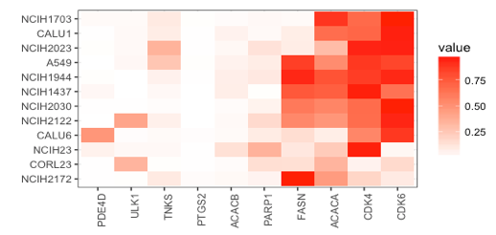
Compare the CRISPR and compound screening results
Achilles results of the 10 no-effect genes
Values in plot are dependency probabilities of a target gene in the cell line
Agrees
Disagrees
FASN
ACACA
CDK4
CDK6
There are many high dependency probability values in the graph (25.% % had probability great than 0.5)
The 10 genes are two times more likely to show high dependency data than random (p: 1.5e-6)
Notes:
12 out of the 21 compound screening cell lines had CRISPR results (derived by Achilles)
Test: Are dependency probabilities of these genes significantly skewed than expected ?
Method: Prevalence of high dependency data point (probability > 0.5) in the 10 genes versus all the genes
Target selection bias? Low potent compounds? Compound annotation issues? Small numbers skewed the statistics?

Slide 9
Compound group 2: strong effects in all cell lines

Slide 10
Compound group 2: strong effects in all cell lines
Compound | Target | Target gene
L-002486963-000N032 | CDK 2, 5, 1, 9 | CDK1, CDK2, CDK5, CDK9
L-006059585-000G002 | ER stress | ATP2A1, ATP2A2, ATP2A3
L-001993364-000X006 | microtubule stabilizer | TUBB1
L-002488444-000C005 | mTOR kinase inh | MTOR
L-005417137-000C002 | mTOR kinase inh | MTOR
What the CRISPR results look like for these target genes?
Since Achilles CRISPR only delete genes, we remove activating compounds from the analysis (AMPK targets)

Slide 11
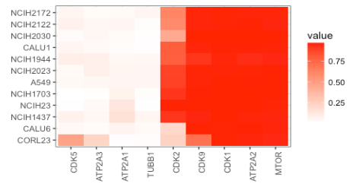
Compare the CRISPR and compound screening results
Achilles results of the 9 highly effective genes
Values in plot are dependency probabilities of a target gene in the cell line
Disagrees
Agrees
CDK5
ATP2A3
ATP2A1
TUBB1
There are many low dependency probability values in the graph (47% had probability less than 0.5)
The 9 genes are 8.67 times more likely to show high dependency data than random (p: 1.5e-6)
Notes:
Target selection bias? Low potent compounds? Compound annotation issues? Small numbers skewed the statistics?

Slide 12
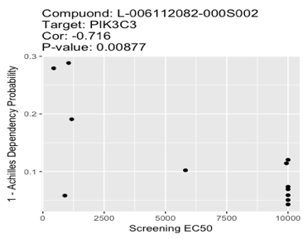
Compound group 3: varying effects across the cell lines
Compound | Target | Target_gene
L-005151539-000N005 | PIK3CD | PIK3CD
L-006276750-000G002 | HDAC4 | HDAC4
L-001948211-003H001 | AKT 1 | AKT1
L-006369882-000J002 | ALK | ALK
L-005131606-001U004 | antifolate chemotherapeutic
L-006308651-000Z001 | CAMKII | CAMK2A
L-000608157-000J016 | DNA methylation inh
L-001986937-000Z002 | EGFR | EGFR
L-000642886-000K004 | ER stress
L-000728614-000U013 | ER stress
L-004111481-000B004 | ERK | MAPK1
L-005292344-000X004 | FLT3 | FLT3
L-006340710-000F001 | HDAC4/5 | HDAC4, HDAC5
L-000644128-000U268 | HMGCR | HMGCR
L-002135210-000G005 | HSP90
L-001998385-000N012 | MEK1 | MAP2K1
L-002102468-000G004 | MEK1 | MAP2K1
L-002488444-000C002 | mTOR kinase inh
L-003582950-000H002 | mTOR kinase inh
L-006339683-000F001 | mTOR kinase inh
L-002114116-000B003 | mTOR rapalog - mTORC1
L-002952254-000G006 | mTOR rapalog - mTORC1
L-000573270-000R025 | Nuc analog
L-001184291-000T001 | p70S6K
L-005417492-000T002 | P70S6K
L-000638125-000G034 | pan-kinase
L-006340309-000C001 | Phos. Inhibitor
L-002303931-000U003 | PIK3 unselective
L-002382660-000B006 | PIK3CA | PIK3CA
L-005209557-000V003 | PIK3CD | PIK3CD
L-006338063-000T001 | PIK3CG | PIK3CG
L-000089971-000H010 | Resp chain inhibitor
L-001998390-000M004 | SRC/Abl
L-001397012-000X024 | TopoI/DNA
L-006112082-000S002 | VSP34/PIK3C3 | VSP34, PIK3C3
L-001739996-002F002 | WEE1 | WEE1
Resolved 15 target genes for the 34 compounds that showed variable effects across the cells
Ask: how correlated the compounds screening results and Achilles results are?
* An example for the PIK3C3 gene; each dot is a cell

Slide 13
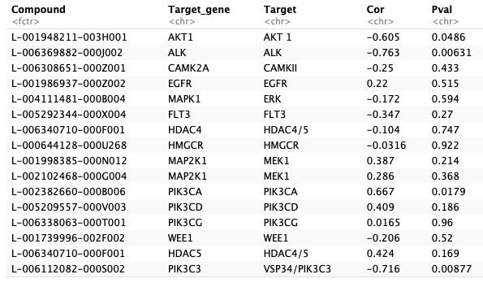
Compound group 3: variable effects across the cell lines
4 out of 16 tests showed modest correlations
None of the 4 significant associations survived multiple comparison corrections
3 out of the 4 significant associations were reverse association (activators?)

Slide 14
Summary
Compound screening and CRISPR deliver different results
It is not clear which method delivers better results

